Slide 1

Analysis of Algorithms
CS 477/677 https://www.cse.unr.edu/~bebis/CS477/Lect/DynamicProgramming.ppt
Dynamic Programming
Instructor: George Bebis
(Chapter 15)

Slide 2
Dynamic Programming
An algorithm design technique (like divide and conquer)
Divide and conquer
  Partition the problem into independent subproblems
  Solve the subproblems recursively
  Combine the solutions to solve the original problem

Slide 3
Dynamic Programming
Applicable when subproblems are not independent
  Subproblems share subsubproblems
E.g.: Combinations:
  A divide and conquer approach would repeatedly solve the common subproblems
  Dynamic programming solves every subproblem just once and stores the answer in a table
n
k
=
n-1
k
n-1
k-1
+
n
1
=1
n
n
=1

Slide 4
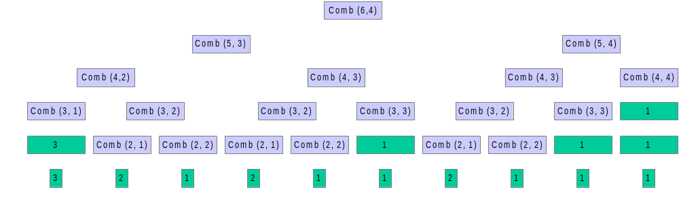
Example: Combinations
n
k
=
n-1
k
n-1
k-1
+

Slide 5
Dynamic Programming
Used for optimization problems
  A set of choices must be made to get an optimal solution
  Find a solution with the optimal value (minimum or maximum)
  There may be many solutions that lead to an optimal value
  Our goal: find an optimal solution

Slide 6
Dynamic Programming Algorithm
Characterize the structure of an optimal solution
Recursively define the value of an optimal solution
Compute the value of an optimal solution in a bottom-up fashion
Construct an optimal solution from computed information (not always necessary)

Slide 7
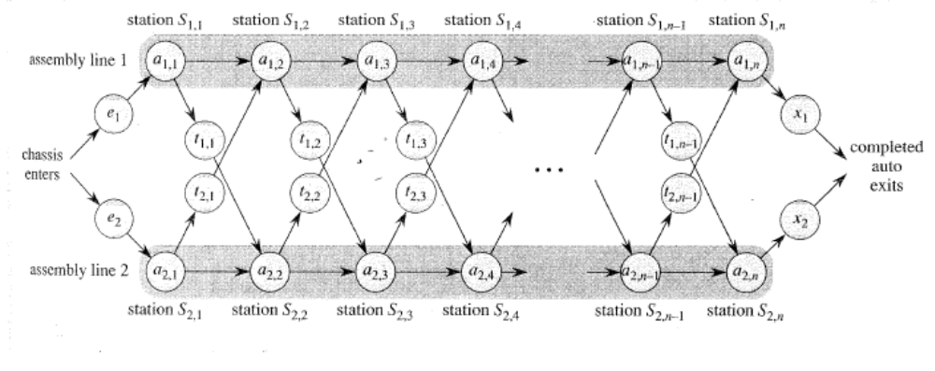
Assembly Line Scheduling
Automobile factory with two assembly lines
  Each line has n stations: S_{1,1}, . . . , S_{1,n} and S_{2,1}, . . . , S_{2,n}
  Corresponding stations S_{1, j} and S_{2, j} perform the same function but can take different amounts of time a_{1, j} and a_{2, j}
  Entry times are: e₁ and e₂; exit times are: x₁ and x₂

Slide 8
Assembly Line Scheduling
After going through a station, can either:
  stay on same line at no cost, or
  transfer to other line: cost after S_{i,j} is t_{i,j} , j = 1, . . . , n - 1

Slide 9
How many ways are there for a car to be manufactured?
Question: Which among them is the minimum cost path
While inspecting certain paths do you see an amount of common computation done – however this still means exploring all paths
Will optimal solution at one point depend on optimal solution of any previous points?

Slide 10
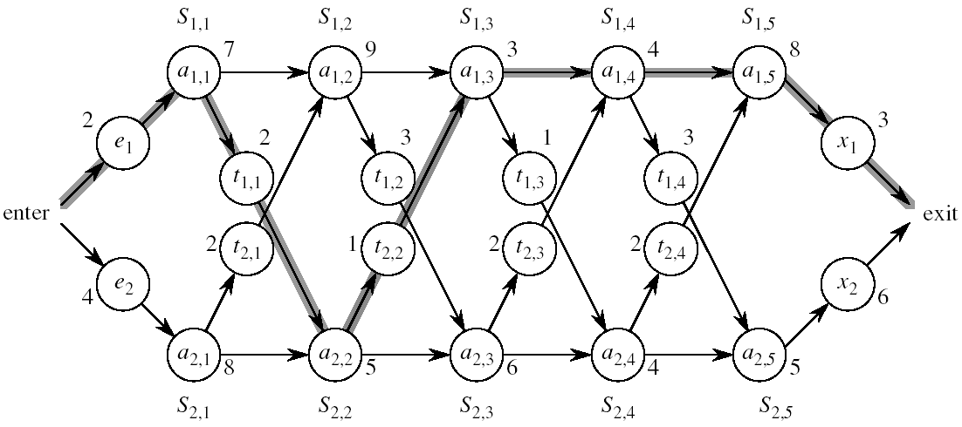
Assembly Line Scheduling
Problem:
what stations should be chosen from line 1 and which from line 2 in order to minimize the total time through the factory for one car?

Slide 11
One Solution
Brute force
  Enumerate all possibilities of selecting stations
  Compute how long it takes in each case and choose the best one
Solution:
  There are 2^{n} possible ways to choose stations
  Infeasible when n is large!!
1
2
3
4
n
1
0
0
1
1
0 if choosing line 2
at step j (= 3)
1 if choosing line 1
at step j (= n)

Slide 12
1. Structure of the Optimal Solution
How do we compute the minimum time of going through a station?

Slide 13
1. Structure of the Optimal Solution
Let’s consider all possible ways to get from the starting point through station S_{1,j}
  We have two choices of how to get to S_{1, j}:
    Through S_{1, j - 1}, then directly to S_{1, j}
    Through S_{2, j - 1}, then transfer over to S_{1, j}
S_{1,j-1}
S_{1,j}
Line 1
a_{1,j-1}
a_{1,j}
t_{2,j-1}
Line 2
a_{2,j-1}
S_{2,j-1}

Slide 14
1. Structure of the Optimal Solution
Suppose that the fastest way through S_{1, j} is through S_{1, j – 1}
  We must have taken a fastest way from entry through S_{1, j – 1}
  If there were a faster way through S_{1, j - 1}, we would use it instead
Similarly for S_{2, j – 1}
S_{1,j-1}
S_{1,j}
Line 1
a_{1,j-1}
a_{1,j}
Optimal Substructure
t_{2,j-1}
a_{2,j-1}
Line 2
S_{2,j-1}

Slide 15
Optimal Substructure
Generalization: an optimal solution to the problem “find the fastest way through S_{1, j}” contains within it an optimal solution to subproblems: “find the fastest way through S_{1, j - 1} or S_{2, j – 1}”.
This is referred to as the optimal substructure property
We use this property to construct an optimal solution to a problem from optimal solutions to subproblems

Slide 16
2. A Recursive Solution
Define the value of an optimal solution in terms of the optimal solution to subproblems

Slide 17
2. A Recursive Solution (cont.)
Definitions:
  f* : the fastest time to get through the entire factory
  f_{i}[j] : the fastest time to get from the starting point through station S_{i,j}
  f* = min (f₁[n] + x₁, f₂[n] + x₂)

Slide 18
2. A Recursive Solution (cont.)
Base case: j = 1, i=1,2 (getting through station 1)
f₁[1] = e₁ + a_{1,1}
f₂[1] = e₂ + a_{2,1}

Slide 19
2. A Recursive Solution (cont.)
General Case: j = 2, 3, …,n, and i = 1, 2
Fastest way through S_{1, j} is either:
  the way through S_{1, j - 1} then directly through S_{1, j}, or
  f₁[j - 1] + a_{1,j}
  the way through S_{2, j - 1}, transfer from line 2 to line 1, then through S_{1, j}
f₂[j -1] + t_{2,j-1} + a_{1,j}
f₁[j] = min(f₁[j - 1] + a_{1,j} ,f₂[j -1] + t_{2,j-1} + a_{1,j})
S_{1,j-1}
S_{1,j}
Line 1
a_{1,j-1}
a_{1,j}
t_{2,j-1}
a_{2,j-1}
Line 2
S_{2,j-1}

Slide 20
2. A Recursive Solution (cont.)
e₁ + a_{1,1} if j = 1
f₁[j] =
min(f₁[j - 1] + a_{1,j} ,f₂[j -1] + t_{2,j-1} + a_{1,j}) if j ≥ 2
e₂ + a_{2,1} if j = 1
f₂[j] =
min(f₂[j - 1] + a_{2,j} ,f₁[j -1] + t_{1,j-1} + a_{2,j}) if j ≥ 2

Slide 21
3. Computing the Optimal Solution
  f* = min (f₁[n] + x₁, f₂[n] + x₂)
f₁[j] = min(f₁[j - 1] + a_{1,j} ,f₂[j -1] + t_{2,j-1} + a_{1,j})
f₂[j] = min(f₂[j - 1] + a_{2,j} ,f₁[j -1] + t_{1,j-1} + a_{2,j})
Solving top-down would result in exponential running time
1
2
3
4
5
f₁[j]
f₁(1)
f₁(2)
f₁(3)
f₁(4)
f₁(5)
f₂[j]
f₂(1)
f₂(2)
f₂(3)
f₂(4)
f₂(5)
4 times
2 times

Slide 22
3. Computing the Optimal Solution
For j ≥ 2, each value f_{i}[j] depends only on the values of f₁[j – 1] and f₂[j - 1]
Idea: compute the values of f_{i}[j] as follows:
Bottom-up approach
  First find optimal solutions to subproblems
  Find an optimal solution to the problem from the subproblems
in increasing order of j
1
2
3
4
5
f₁[j]
f₂[j]

Slide 23
e₁ + a_{1,1}, if j = 1
f₁[j] = min(f₁[j - 1] + a_{1,j} ,f₂[j -1] + t_{2,j-1} + a_{1,j}) if j ≥ 2
f₁[j]
9
f* = ?
f₂[j]
12

Slide 24
Example
e₁ + a_{1,1}, if j = 1
f₁[j] = min(f₁[j - 1] + a_{1,j} ,f₂[j -1] + t_{2,j-1} + a_{1,j}) if j ≥ 2
1
2
3
4
5
f₁[j]
9
18^{[1]}
20^{[2]}
24^{[1]}
32^{[1]}
f* = 35^{[1]}
f₂[j]
12
16^{[1]}
22^{[2]}
25^{[1]}
30^{[2]}

Slide 25
FASTEST-WAY(a, t, e, x, n)
f₁[1] ← e₁ + a_{1,1}
f₂[1] ← e₂ + a_{2,1}
for j ← 2 to n
do if f₁[j - 1] + a_{1,j} ≤ f₂[j - 1] + t_{2, j-1} + a_{1, j}
then f₁[j] ← f₁[j - 1] + a_{1, j}
l₁[j] ← 1
else f₁[j] ← f₂[j - 1] + t_{2, j-1} + a_{1, j}
l₁[j] ← 2
if f₂[j - 1] + a_{2, j} ≤ f₁[j - 1] + t_{1, j-1} + a_{2, j}
then f₂[j] ← f₂[j - 1] + a_{2, j}
l₂[j] ← 2
else f₂[j] ← f₁[j - 1] + t_{1, j-1} + a_{2, j}
l₂[j] ← 1
Compute initial values of f₁ and f₂
O(N)
Compute the values of
f₁[j] and l₁[j]
Compute the values of
f₂[j] and l₂[j]

Slide 26
FASTEST-WAY(a, t, e, x, n) (cont.)
if f₁[n] + x₁ ≤ f₂[n] + x₂
then f* = f₁[n] + x₁
l* = 1
else f* = f₂[n] + x₂
l* = 2
Compute the values of
the fastest time through the
entire factory

Slide 27
4. Construct an Optimal Solution
Alg.: PRINT-STATIONS(l, n)
i ← l*
print “line ” i “, station ” n
for j ← n downto 2
do i ←l_{i}[j]
print “line ” i “, station ” j - 1
1
2
3
4
5
f₁[j]/l₁[j]
9
18^{[1]}
20^{[2]}
24^{[1]}
32^{[1]}
l* = 1
f₂[j]/l₂[j]
12
16^{[1]}
22^{[2]}
25^{[1]}
30^{[2]}

Slide 28
Matrix-Chain Multiplication
Problem: given a sequence ⟨A₁, A₂, …, A_{n}⟩, compute the product:
A₁ ⋅ A₂ ⋅⋅⋅ A_{n}
Matrix compatibility:
C = A ⋅ B C=A₁ ⋅ A₂ ⋅⋅⋅ A_{i} ⋅ A_{i+1} ⋅⋅⋅ A_{n}
col_{A} = row_{B} col_{i} = row_{i+1}
row_{C} = row_{A} row_{C} = row_{A1}
col_{C} = col_{B} col_{C} = col_{An}

Slide 29
MATRIX-MULTIPLY(A, B)
if columns[A] ≠ rows[B]
then error “incompatible dimensions”
else for i ← 1 to rows[A]
do for j ← 1 to columns[B]
do C[i, j] = 0
for k ← 1 to columns[A]
do C[i, j] ← C[i, j] + A[i, k] B[k, j]
rows[A] ⋅ cols[A] ⋅ cols[B]
multiplications
k
j
cols[B]
j
cols[B]
i
*
=
i
k
A
B
C
rows[A]
rows[A]

Slide 30
Matrix-Chain Multiplication
In what order should we multiply the matrices?
A₁ ⋅ A₂ ⋅⋅⋅ A_{n}
Parenthesize the product to get the order in which matrices are multiplied
E.g.: A₁ ⋅ A₂ ⋅ A₃ = ((A₁ ⋅ A₂) ⋅ A₃)
= (A₁ ⋅ (A₂ ⋅ A₃))
Which one of these orderings should we choose?
  The order in which we multiply the matrices has a significant impact on the cost of evaluating the product

Slide 31
Example
A₁ ⋅ A₂ ⋅ A₃
A₁: 10 x 100
A₂: 100 x 5
A₃: 5 x 50
1. ((A₁ ⋅ A₂) ⋅ A₃): A₁ ⋅ A₂ = 10 x 100 x 5 = 5,000 (10 x 5)
((A₁ ⋅ A₂) ⋅ A₃) = 10 x 5 x 50 = 2,500
Total: 7,500 scalar multiplications
2. (A₁ ⋅ (A₂ ⋅ A₃)): A₂ ⋅ A₃ = 100 x 5 x 50 = 25,000 (100 x 50)
(A₁ ⋅ (A₂ ⋅ A₃)) = 10 x 100 x 50 = 50,000
Total: 75,000 scalar multiplications
one order of magnitude difference!!

Slide 32
Matrix-Chain Multiplication:
Problem Statement
Given a chain of matrices ⟨A₁, A₂, …, A_{n}⟩, where A_{i} has dimensions p_{i-1}x p_{i}, fully parenthesize the product A₁ ⋅ A₂ ⋅⋅⋅ A_{n} in a way that minimizes the number of scalar multiplications.
A₁ ⋅ A₂ ⋅⋅⋅ A_{i} ⋅ A_{i+1} ⋅⋅⋅ A_{n}
p₀ x p₁ p₁ x p₂ p_{i-1} x p_{i} p_{i} x p_{i+1} p_{n-1} x p_{n}

Slide 33
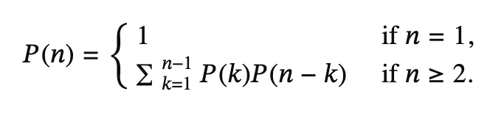
What is the number of possible parenthesizations?
Exhaustively checking all possible parenthesizations is not efficient!
It can be shown that the number of parenthesizations grows as Ω(4^{n}/n^{3/2})
(see page 333 in your textbook)

Slide 34
1. The Structure of an Optimal Parenthesization
Notation:
A_{i…j} = A_{i} A_{i+1} ⋅⋅⋅ A_{j}, i ≤ j
Suppose that an optimal parenthesization of A_{i…j} splits the product between A_{k} and A_{k+1}, where i ≤ k < j
A_{i…j} = A_{i} A_{i+1} ⋅⋅⋅ A_{j}
= A_{i} A_{i+1} ⋅⋅⋅ A_{k} A_{k+1} ⋅⋅⋅ A_{j}
= A_{i…k} A_{k+1…j}

Slide 35
Optimal Substructure
A_{i…j} = A_{i…k} A_{k+1…j}
The parenthesization of the “prefix” A_{i…k} must be an optimal parentesization
If there were a less costly way to parenthesize A_{i…k}, we could substitute that one in the parenthesization of A_{i…j} and produce a parenthesization with a lower cost than the optimum ⇒ contradiction!
An optimal solution to an instance of the matrix-chain multiplication contains within it optimal solutions to subproblems

Slide 36
2. A Recursive Solution
Subproblem:
determine the minimum cost of parenthesizing A_{i…j} = A_{i} A_{i+1} ⋅⋅⋅ A_{j} for 1 ≤ i ≤ j ≤ n
Let m[i, j] = the minimum number of multiplications needed to compute A_{i…j}
  full problem (A_{1..n}): m[1, n]
  i = j: A_{i…i} = A_{i} ⇒ m[i, i] =
  0, for i = 1, 2, …, n

Slide 37
2. A Recursive Solution
Consider the subproblem of parenthesizing A_{i…j} = A_{i} A_{i+1} ⋅⋅⋅ A_{j} for 1 ≤ i ≤ j ≤ n
= A_{i…k} A_{k+1…j} for i ≤ k < j
Assume that the optimal parenthesization splits the product A_{i} A_{i+1} ⋅⋅⋅ A_{j} at k (i ≤ k < j)
  m[i, j] =
p_{i-1}p_{k}p_{j}
m[i, k]
m[k+1,j]
m[i, k] + m[k+1, j] + p_{i-1}p_{k}p_{j}
min # of multiplications
to compute A_{i…k}
min # of multiplications
to compute A_{k+1…j}
# of multiplications
to compute A_{i…k}A_{k…j}

Slide 38
2. A Recursive Solution (cont.)
  m[i, j] = m[i, k] + m[k+1, j] + p_{i-1}p_{k}p_{j}
We do not know the value of k
  There are j – i possible values for k: k = i, i+1, …, j-1
Minimizing the cost of parenthesizing the product A_{i} A_{i+1} ⋅⋅⋅ A_{j} becomes:
0 if i = j
m[i, j] = min {m[i, k] + m[k+1, j] + p_{i-1}p_{k}p_{j}} if i < j
^{i≤k<j}

Slide 39
3. Computing the Optimal Costs
0 if i = j
m[i, j] = min {m[i, k] + m[k+1, j] + p_{i-1}p_{k}p_{j}} if i < j
^{i≤k<j}
Computing the optimal solution recursively takes exponential time!
How many subproblems?
  Parenthesize A_{i…j}
  for 1 ≤ i ≤ j ≤ n
  One problem for each
  choice of i and j
1
2
3
n
n
⇒ Θ(n²)
j
3
2
1
i

Slide 40
3. Computing the Optimal Costs (cont.)
0 if i = j
m[i, j] = min {m[i, k] + m[k+1, j] + p_{i-1}p_{k}p_{j}} if i < j
^{i≤k<j}
How do we fill in the tables m[1..n, 1..n]?
  Determine which entries of the table are used in computing m[i, j]
  A_{i…j} = A_{i…k} A_{k+1…j}
  Subproblems’ size is one less than the original size
  Idea: fill in m such that it corresponds to solving problems of increasing length

Slide 41
3. Computing the Optimal Costs (cont.)
0 if i = j
m[i, j] = min {m[i, k] + m[k+1, j] + p_{i-1}p_{k}p_{j}} if i < j
^{i≤k<j}
Length = 1: i = j, i = 1, 2, …, n
Length = 2: j = i + 1, i = 1, 2, …, n-1
second
first
1
2
3
n
n
m[1, n] gives the optimal
solution to the problem
j
Compute rows from bottom to top and from left to right
3
2
1
i

Slide 42
Example: min {m[i, k] + m[k+1, j] + p_{i-1}p_{k}p_{j}}
m[2, 2] + m[3, 5] + p₁p₂p₅
m[2, 3] + m[4, 5] + p₁p₃p₅
m[2, 4] + m[5, 5] + p₁p₄p₅
k = 2
m[2, 5] = min
k = 3
k = 4
1
2
3
4
5
6
6
5
Values m[i, j] depend only on values that have been previously computed
4
j
3
2
1
i

Slide 43
Example min {m[i, k] + m[k+1, j] + p_{i-1}p_{k}p_{j}}
1
2
3
Compute A₁ ⋅ A₂ ⋅ A₃
A₁: 10 x 100 (p₀ x p₁)
A₂: 100 x 5 (p₁ x p₂)
A₃: 5 x 50 (p₂ x p₃)
m[i, i] = 0 for i = 1, 2, 3
m[1, 2] = m[1, 1] + m[2, 2] + p₀p₁p₂ (A₁A₂)
= 0 + 0 + 10 *100* 5 = 5,000
m[2, 3] = m[2, 2] + m[3, 3] + p₁p₂p₃ (A₂A₃)
= 0 + 0 + 100 * 5 * 50 = 25,000
m[1, 3] = min m[1, 1] + m[2, 3] + p₀p₁p₃ = 75,000 (A₁(A₂A₃))
m[1, 2] + m[3, 3] + p₀p₂p₃ = 7,500 ((A₁A₂)A₃)
3
2
2
7500
25000
0
2
1
5000
0
1
0

Slide 44
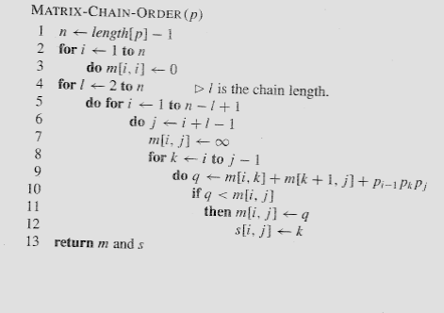
Matrix-Chain-Order(p)
O(N³)

Slide 45
4. Construct the Optimal Solution
In a similar matrix s we keep the optimal values of k
s[i, j] = a value of k such that an optimal parenthesization of A_{i..j} splits the product between A_{k} and A_{k+1}
1
2
3
n
n
 |  | k
j
3
2
1

Slide 46
4. Construct the Optimal Solution
s[1, n] is associated with the entire product A_{1..n}
  The final matrix multiplication will be split at k = s[1, n]
  A_{1..n} = A_{1..s[1, n]} ⋅ A_{s[1, n]+1..n}
  For each subproduct recursively find the corresponding value of k that results in an optimal parenthesization
1
2
3
n
n
j
3
2
1

Slide 47
4. Construct the Optimal Solution
s[i, j] = value of k such that the optimal parenthesization of A_{i} A_{i+1} ⋅⋅⋅ A_{j} splits the product between A_{k} and A_{k+1}
1
2
3
4
5
6
6
3 | 3 | 3 | 5 | 5 | -
3 | 3 | 3 | 4 | -
3 | 3 | 3 | -
1 | 2 | -
1 | -
-
s[1, n] = 3 ⇒ A_{1..6} = A_{1..3} A_{4..6}
s[1, 3] = 1 ⇒ A_{1..3} = A_{1..1} A_{2..3}
s[4, 6] = 5 ⇒ A_{4..6} = A_{4..5} A_{6..6}
5
4
3
j
2
1
i

Slide 48
4. Construct the Optimal Solution (cont.)
PRINT-OPT-PARENS(s, i, j)
if i = j
then print “A”_{i}
else print “(”
PRINT-OPT-PARENS(s, i, s[i, j])
PRINT-OPT-PARENS(s, s[i, j] + 1, j)
print “)”
1
2
3
4
5
6
6
3 | 3 | 3 | 5 | 5 | -
3 | 3 | 3 | 4 | -
3 | 3 | 3 | -
1 | 2 | -
1 | -
-
5
4
j
3
2
1
i

Slide 49
Example: A₁⋅ ⋅ ⋅A₆
(
(
A₁
(
A₂
A₃
)
)
( ( A₄ A₅ ) A₆ ) )
s[1..6, 1..6]
1
2
3
4
5
6
PRINT-OPT-PARENS(s, i, j)
if i = j
then print “A”_{i}
else print “(”
PRINT-OPT-PARENS(s, i, s[i, j])
PRINT-OPT-PARENS(s, s[i, j] + 1, j)
print “)”
6
3 | 3 | 3 | 5 | 5 | -
3 | 3 | 3 | 4 | -
3 | 3 | 3 | -
1 | 2 | -
1 | -
-
5
4
j
3
2
1
P-O-P(s, 1, 6) s[1, 6] = 3
i = 1, j = 6 “(“ P-O-P (s, 1, 3) s[1, 3] = 1
i = 1, j = 3 “(“ P-O-P(s, 1, 1) ⇒ “A₁”
P-O-P(s, 2, 3) s[2, 3] = 2
i = 2, j = 3 “(“ P-O-P (s, 2, 2) ⇒ “A₂”
P-O-P (s, 3, 3) ⇒ “A₃”
“)”
“)”
i
…

Slide 50
Memoization
Top-down approach with the efficiency of typical dynamic programming approach
Maintaining an entry in a table for the solution to each subproblem
  memoize the inefficient recursive algorithm
When a subproblem is first encountered its solution is computed and stored in that table
Subsequent “calls” to the subproblem simply look up that value

Slide 51
Memoized Matrix-Chain
Alg.: MEMOIZED-MATRIX-CHAIN(p)
n ← length[p] – 1
for i ← 1 to n
do for j ← i to n
do m[i, j] ← ∞
return LOOKUP-CHAIN(p, 1, n)
Initialize the m table with
large values that indicate
whether the values of m[i, j]
have been computed
Top-down approach

Slide 52
Memoized Matrix-Chain
Alg.: LOOKUP-CHAIN(p, i, j)
if m[i, j] < ∞
then return m[i, j]
if i = j
then m[i, j] ← 0
else for k ← i to j – 1
do q ← LOOKUP-CHAIN(p, i, k) +
LOOKUP-CHAIN(p, k+1, j) + p_{i-1}p_{k}p_{j}
if q < m[i, j]
then m[i, j] ← q
return m[i, j]
Running time is O(n³)

Slide 53
Dynamic Progamming vs. Memoization
Advantages of dynamic programming vs. memoized algorithms
  No overhead for recursion, less overhead for maintaining the table
  The regular pattern of table accesses may be used to reduce time or space requirements
Advantages of memoized algorithms vs. dynamic programming
  Some subproblems do not need to be solved

Slide 54
Matrix-Chain Multiplication - Summary
Both the dynamic programming approach and the memoized algorithm can solve the matrix-chain multiplication problem in O(n³)
Both methods take advantage of the overlapping subproblems property
There are only Θ(n²) different subproblems
  Solutions to these problems are computed only once
Without memoization the natural recursive algorithm runs in exponential time

Slide 55
Elements of Dynamic Programming
Optimal Substructure
  An optimal solution to a problem contains within it an optimal solution to subproblems
  Optimal solution to the entire problem is build in a bottom-up manner from optimal solutions to subproblems
Overlapping Subproblems
  If a recursive algorithm revisits the same subproblems over and over ⇒ the problem has overlapping subproblems

Slide 56
Work Out Example
A: 2 X 3
B: 3 X 6
C: 6 X 4
D: 4 X 5

Slide 57
Parameters of Optimal Substructure
How many subproblems are used in an optimal solution for the original problem
  Assembly line:
  Matrix multiplication:
How many choices we have in determining which subproblems to use in an optimal solution
  Assembly line:
  Matrix multiplication:
One subproblem (the line that gives best time)
Two subproblems (subproducts A_{i..k}, A_{k+1..j})
Two choices (line 1 or line 2)
j - i choices for k (splitting the product)

Slide 58
Parameters of Optimal Substructure
Intuitively, the running time of a dynamic programming algorithm depends on two factors:
  Number of subproblems overall
  How many choices we look at for each subproblem
Assembly line
  Θ(n) subproblems (n stations)
  2 choices for each subproblem
Matrix multiplication:
  Θ(n²) subproblems (1 ≤ i ≤ j ≤ n)
  At most n-1 choices
Θ(n) overall
Θ(n³) overall

Slide 59
Longest Common Subsequence
Given two sequences
X = ⟨x₁, x₂, …, x_{m}⟩
Y = ⟨y₁, y₂, …, y_{n}⟩
find a maximum length common subsequence (LCS) of X and Y
E.g.:
X = ⟨A, B, C, B, D, A, B⟩
Subsequences of X:
  A subset of elements in the sequence taken in order
⟨A, B, D⟩, ⟨B, C, D, B⟩, etc.

Slide 60
Example
X = ⟨A, B, C, B, D, A, B⟩ X = ⟨A, B, C, D,K,L, A, B⟩
Y = ⟨B, D, C, A, B, A⟩ Y = ⟨B, D, K,L,C, A, B, A⟩
⟨B, C, B, A⟩ and ⟨B, D,K,L, A, B⟩ are longest common subsequences of X and Y (length = 4)
⟨B, C, A⟩, however is not a LCS of X and Y
Note: the second pattern BDKLAB will not be found
once the C of X maps to C of Y. Hence a subproblem
should check for situation when an alphabet is not
selected which implies that we need to fill first column,
First row, then second column, second row and so on

Slide 61
Brute-Force Solution
For every subsequence of X, check whether it’s a subsequence of Y
There are 2^{m} subsequences of X to check
Each subsequence takes Θ(n) time to check
  scan Y for first letter, from there scan for second, and so on
Running time: Θ(n2^{m})

Slide 62
Making the choice
X = ⟨A, B, D, E⟩
Y = ⟨Z, B, E⟩
Choice: include one element into the common sequence (E) and solve the resulting subproblem
X = ⟨A, B, D, G⟩
Y = ⟨Z, B, D⟩
Choice: exclude an element from a string and solve the resulting subproblem

Slide 63
Notations
Given a sequence X = ⟨x₁, x₂, …, x_{m}⟩ we define the i-th prefix of X, for i = 0, 1, 2, …, m
X_{i} = ⟨x₁, x₂, …, x_{i}⟩
c[i, j] = the length of a LCS of the sequences X_{i} = ⟨x₁, x₂, …, x_{i}⟩ and Y_{j} = ⟨y₁, y₂, …, y_{j}⟩

Slide 64
A Recursive Solution
Case 1: x_{i} = y_{j}
e.g.: X_{i} = ⟨A, B, D, E⟩
Y_{j} = ⟨Z, B, E⟩
  Append x_{i} = y_{j} to the LCS of X_{i-1} and Y_{j-1}
  Must find a LCS of X_{i-1} and Y_{j-1} ⇒ optimal solution to a problem includes optimal solutions to subproblems
c[i, j] =
c[i - 1, j - 1] + 1

Slide 65
3. Computing the Length of the LCS
  0 if i = 0 or j = 0
  c[i, j] = c[i-1, j-1] + 1 if x_{i} = y_{j}
  max(c[i, j-1], c[i-1, j]) if x_{i} ≠ y_{j}
0
1
2
n
y_{j:}
y₁
y₂
y_{n}
0
x_{i}
0 | 0 | 0 | 0 | 0 | 0
0
0
0
0
0
X= a b c d a f
Y= a c b c f
1
x₁
first
2
x₂
second
i
m
x_{m}
j

Slide 66
A Recursive Solution
Case 2: x_{i} ≠ y_{j}
e.g.: X_{i} = ⟨A, B, D, G⟩ Y_{j} = ⟨Z, B, D⟩
  Must solve two problems
    find a LCS of X_{i-1} and Y_{j}: X_{i-1} = ⟨A, B, D⟩ and Y_{j} = ⟨Z, B, D⟩ gives 2
    find a LCS of X_{i} and Y_{j-1}: X_{i} = ⟨A, B, D, G⟩ and Y_{j} = ⟨Z, B⟩ gives 1
    Thus LCS of Xi and Yj is max{2,1}=2
c[i, j] =
max { c[i - 1, j], c[i, j-1] }

Slide 67
Overlapping Subproblems
To find a LCS of X and Y
  we may need to find the LCS between X and Y_{n-1} and that of X_{m-1} and Y
  Both the above subproblems has the subproblem of finding the LCS of X_{m-1} and Y_{n-1}
Subproblems share subsubproblems

Slide 68
3. Computing the Length of the LCS
  0 if i = 0 or j = 0
  c[i, j] = c[i-1, j-1] + 1 if x_{i} = y_{j}
  max(c[i, j-1], c[i-1, j]) if x_{i} ≠ y_{j}
0
1
2
n
y_{j:}
y₁
y₂
y_{n}
0
x_{i}
0 | 0 | 0 | 0 | 0 | 0
0
0
0
0
0
1
x₁
first
2
x₂
second
i
m
x_{m}
j

Slide 69
Additional Information
  0 if i,j = 0
c[i, j] = c[i-1, j-1] + 1 if x_{i} = y_{j}
  max(c[i, j-1], c[i-1, j]) if x_{i} ≠ y_{j}
A matrix b[i, j]:
For a subproblem [i, j] it tells us what choice was made to obtain the optimal value
If x_{i} = y_{j}
b[i, j] = “ ”
Else, if c[i - 1, j] ≥ c[i, j-1]
b[i, j] = “ ↑ ”
else
b[i, j] = “ ← ”
b & c:
0
1
2
3
n
y_{j:}
A
C
D
F
0
x_{i}
0 | 0 | 0 | 0 | 0 | 0
0
0
0
0
0
1
A
2
B
c[i-1,j]
i
3
C
c[i,j-1]
m
D
j

Slide 70
LCS-LENGTH(X, Y, m, n)
for i ← 1 to m
do c[i, 0] ← 0
for j ← 0 to n
do c[0, j] ← 0
for i ← 1 to m
do for j ← 1 to n
do if x_{i} = y_{j}
then c[i, j] ← c[i - 1, j - 1] + 1
b[i, j ] ← “ ”
else if c[i - 1, j] ≥ c[i, j - 1]
then c[i, j] ← c[i - 1, j]
b[i, j] ← “↑”
else c[i, j] ← c[i, j - 1]
b[i, j] ← “←”
return c and b
The length of the LCS if one of the sequences
is empty is zero
Case 1: x_{i} = y_{j}
Case 2: x_{i} ≠ y_{j}
Running time: Θ(mn)

Slide 71
Example
  0 if i = 0 or j = 0
  c[i, j] = c[i-1, j-1] + 1 if x_{i} = y_{j}
  max(c[i, j-1], c[i-1, j]) if x_{i} ≠ y_{j}
X = ⟨A, B, C, B, D, A⟩
Y = ⟨B, D, C, A, B, A⟩
0
1
2
3
4
5
6
If x_{i} = y_{j}
b[i, j] = “ ”
Else if c[i - 1, j] ≥ c[i, j-1]
b[i, j] = “ ↑ ”
else
b[i, j] = “ ← ”
y_{j}
B
D
C
A
B
A
0
x_{i}
0
0
0
0
0
0
0
1
A
0
↑
0
↑
0
↑
0
1
1
←1
2
B
0
1
↑
1
2
←1
←1
←2
3
C
0
↑
1
↑
1
2
↑
2
↑
2
←2
4
B
0
1
↑
1
↑
2
↑
2
3
←3
5
D
0
↑
1
2
↑
2
↑
2
↑
3
↑
3
6
A
0
↑
1
↑
2
↑
2
3
↑
3
4
7
B
0
1
↑
2
↑
2
↑
3
4
↑
4

Slide 72
4. Constructing a LCS
Start at b[m, n] and follow the arrows
When we encounter a “ “ in b[i, j] ⇒ x_{i} = y_{j} is an element of the LCS
0
1
2
3
4
5
6
y_{j}
B
D
C
A
B
A
0
x_{i}
0
0
0
0
0
0
0
1
A
0
↑
0
↑
0
↑
0
1
1
←1
2
B
0
1
↑
1
2
←1
←1
←2
3
C
0
↑
1
↑
1
2
↑
2
↑
2
←2
4
B
0
1
↑
1
↑
2
↑
2
3
←3
5
D
0
↑
1
2
↑
2
↑
2
↑
3
↑
3
6
A
0
↑
1
↑
2
↑
2
3
↑
3
4
7
B
0
1
↑
2
↑
2
↑
3
4
↑
4

Slide 73
PRINT-LCS(b, X, i, j)
if i = 0 or j = 0
then return
if b[i, j] = “ ”
then PRINT-LCS(b, X, i - 1, j - 1)
print x_{i}
elseif b[i, j] = “↑”
then PRINT-LCS(b, X, i - 1, j)
else PRINT-LCS(b, X, i, j - 1)
Initial call: PRINT-LCS(b, X, length[X], length[Y])
Running time: Θ(m + n)

Slide 74
Improving the Code
What can we say about how each entry c[i, j] is computed?
  It depends only on c[i -1, j - 1], c[i - 1, j], and c[i, j - 1]
  Eliminate table b and compute in O(1) which of the three values was used to compute c[i, j]
  We save Θ(mn) space from table b
  However, we do not asymptotically decrease the auxiliary space requirements: still need table c

Slide 75
Improving the Code
If we only need the length of the LCS
  LCS-LENGTH works only on two rows of c at a time
    The row being computed and the previous row
  We can reduce the asymptotic space requirements by storing only these two rows

Slide 76
Work out example
X: ABCDAF Y: ACBCF

